Slide 1
OGI Trafford pilot Adrian Bates

Slide 2
Aim
To co-create an interactive tool that draws on Linked Open Statistical Data to help inform the delivery of Jobcentre Plus services in Greater Manchester.

Slide 3
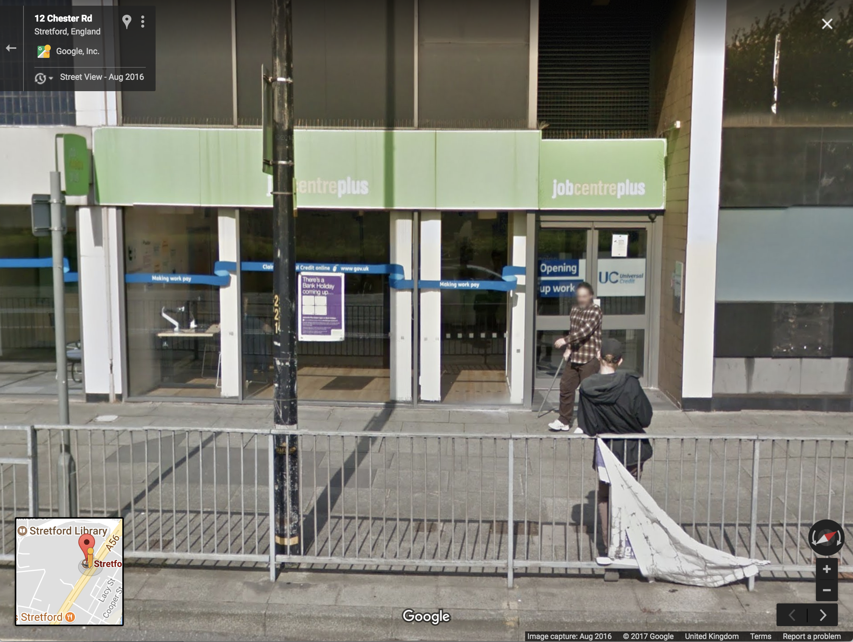

Slide 4
Typical roles
Pilot
Technical partner

Slide 5

Our role
Trafford Pilot
Technical partner

Slide 6
Co-creation

Slide 7
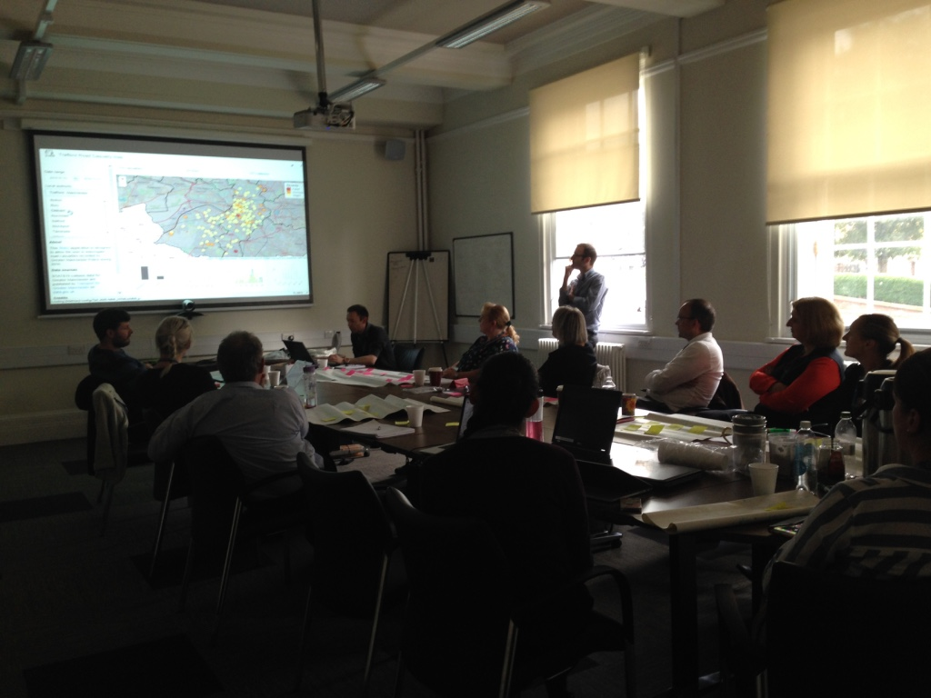

Slide 8
Wish list
- Interactive maps and charts
- Benchmarking
- Data download

Slide 9
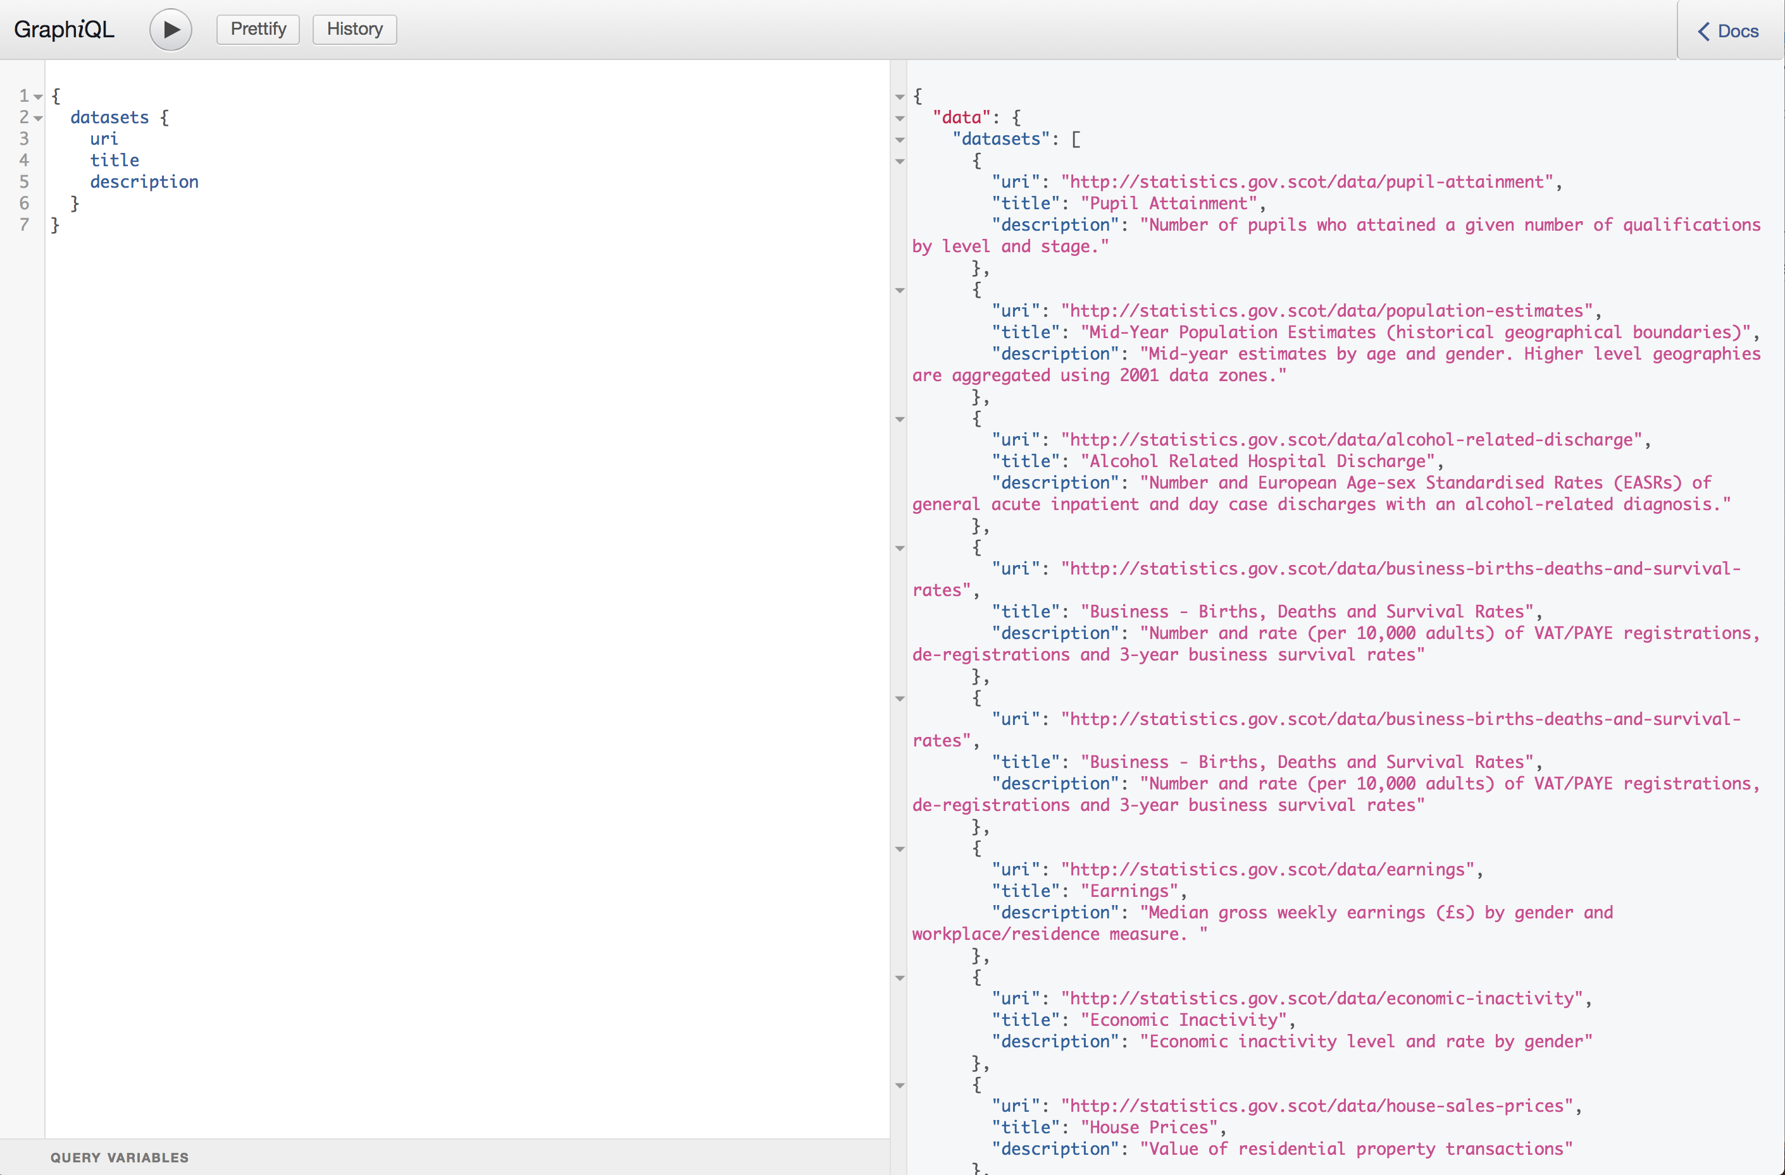
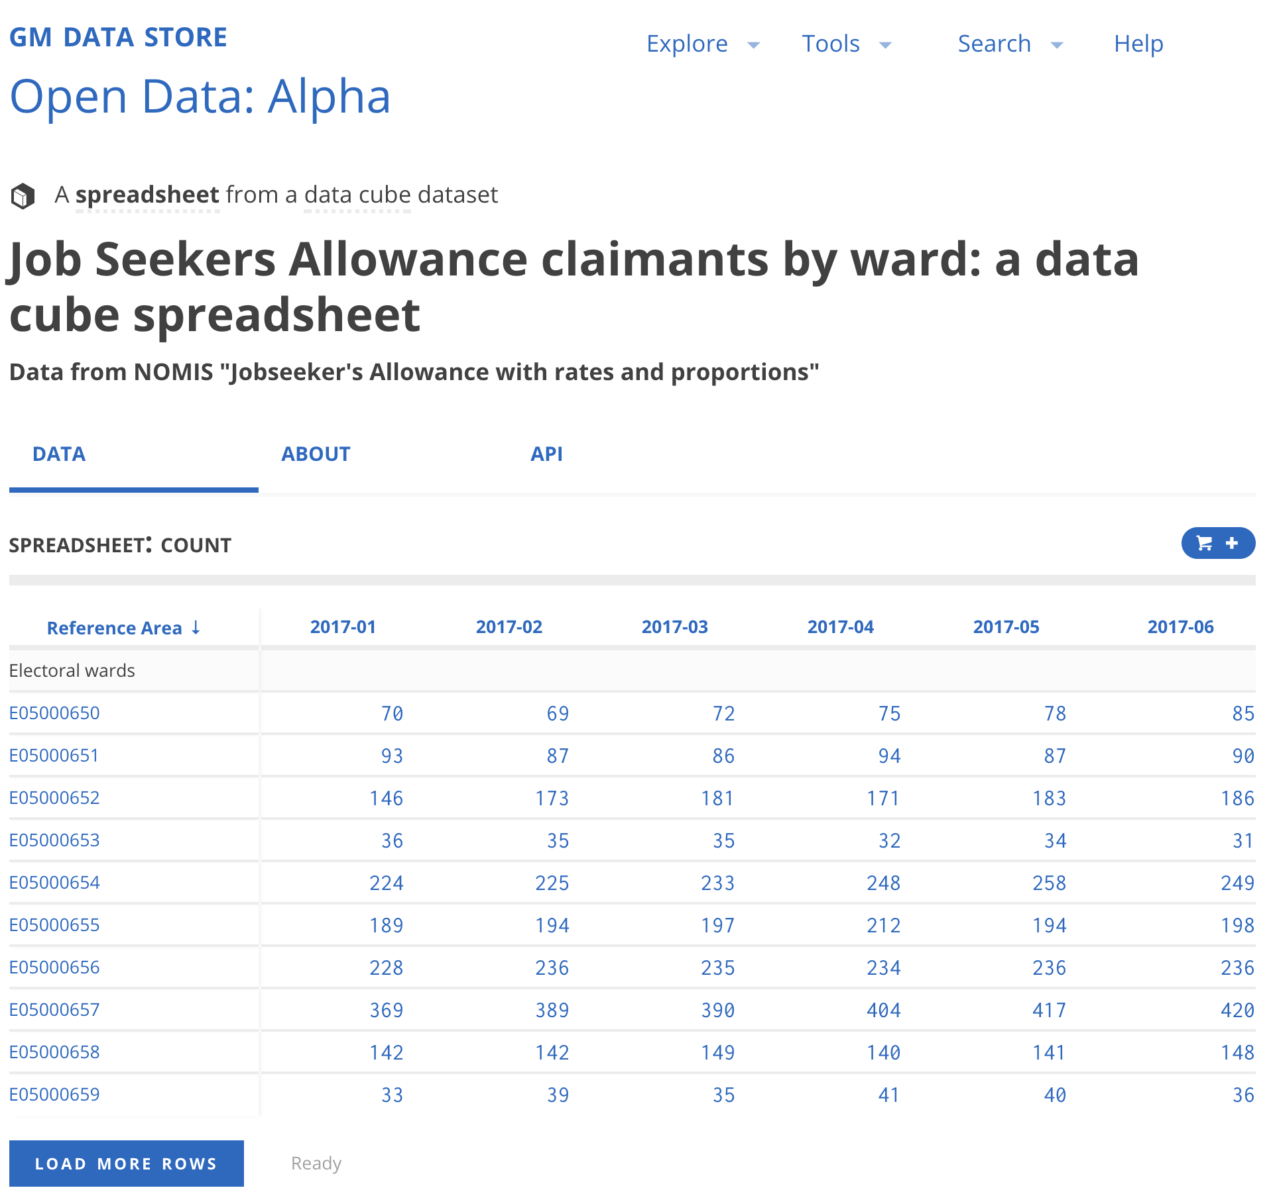
Co-creation: SWIRRL
CubiQL
GM DataStore

Slide 10
Co-creation: Trafford Data Lab
- Literature review
- Available open datasets
- Spatial analysis techniques

Slide 11
App 1.0

Slide 12
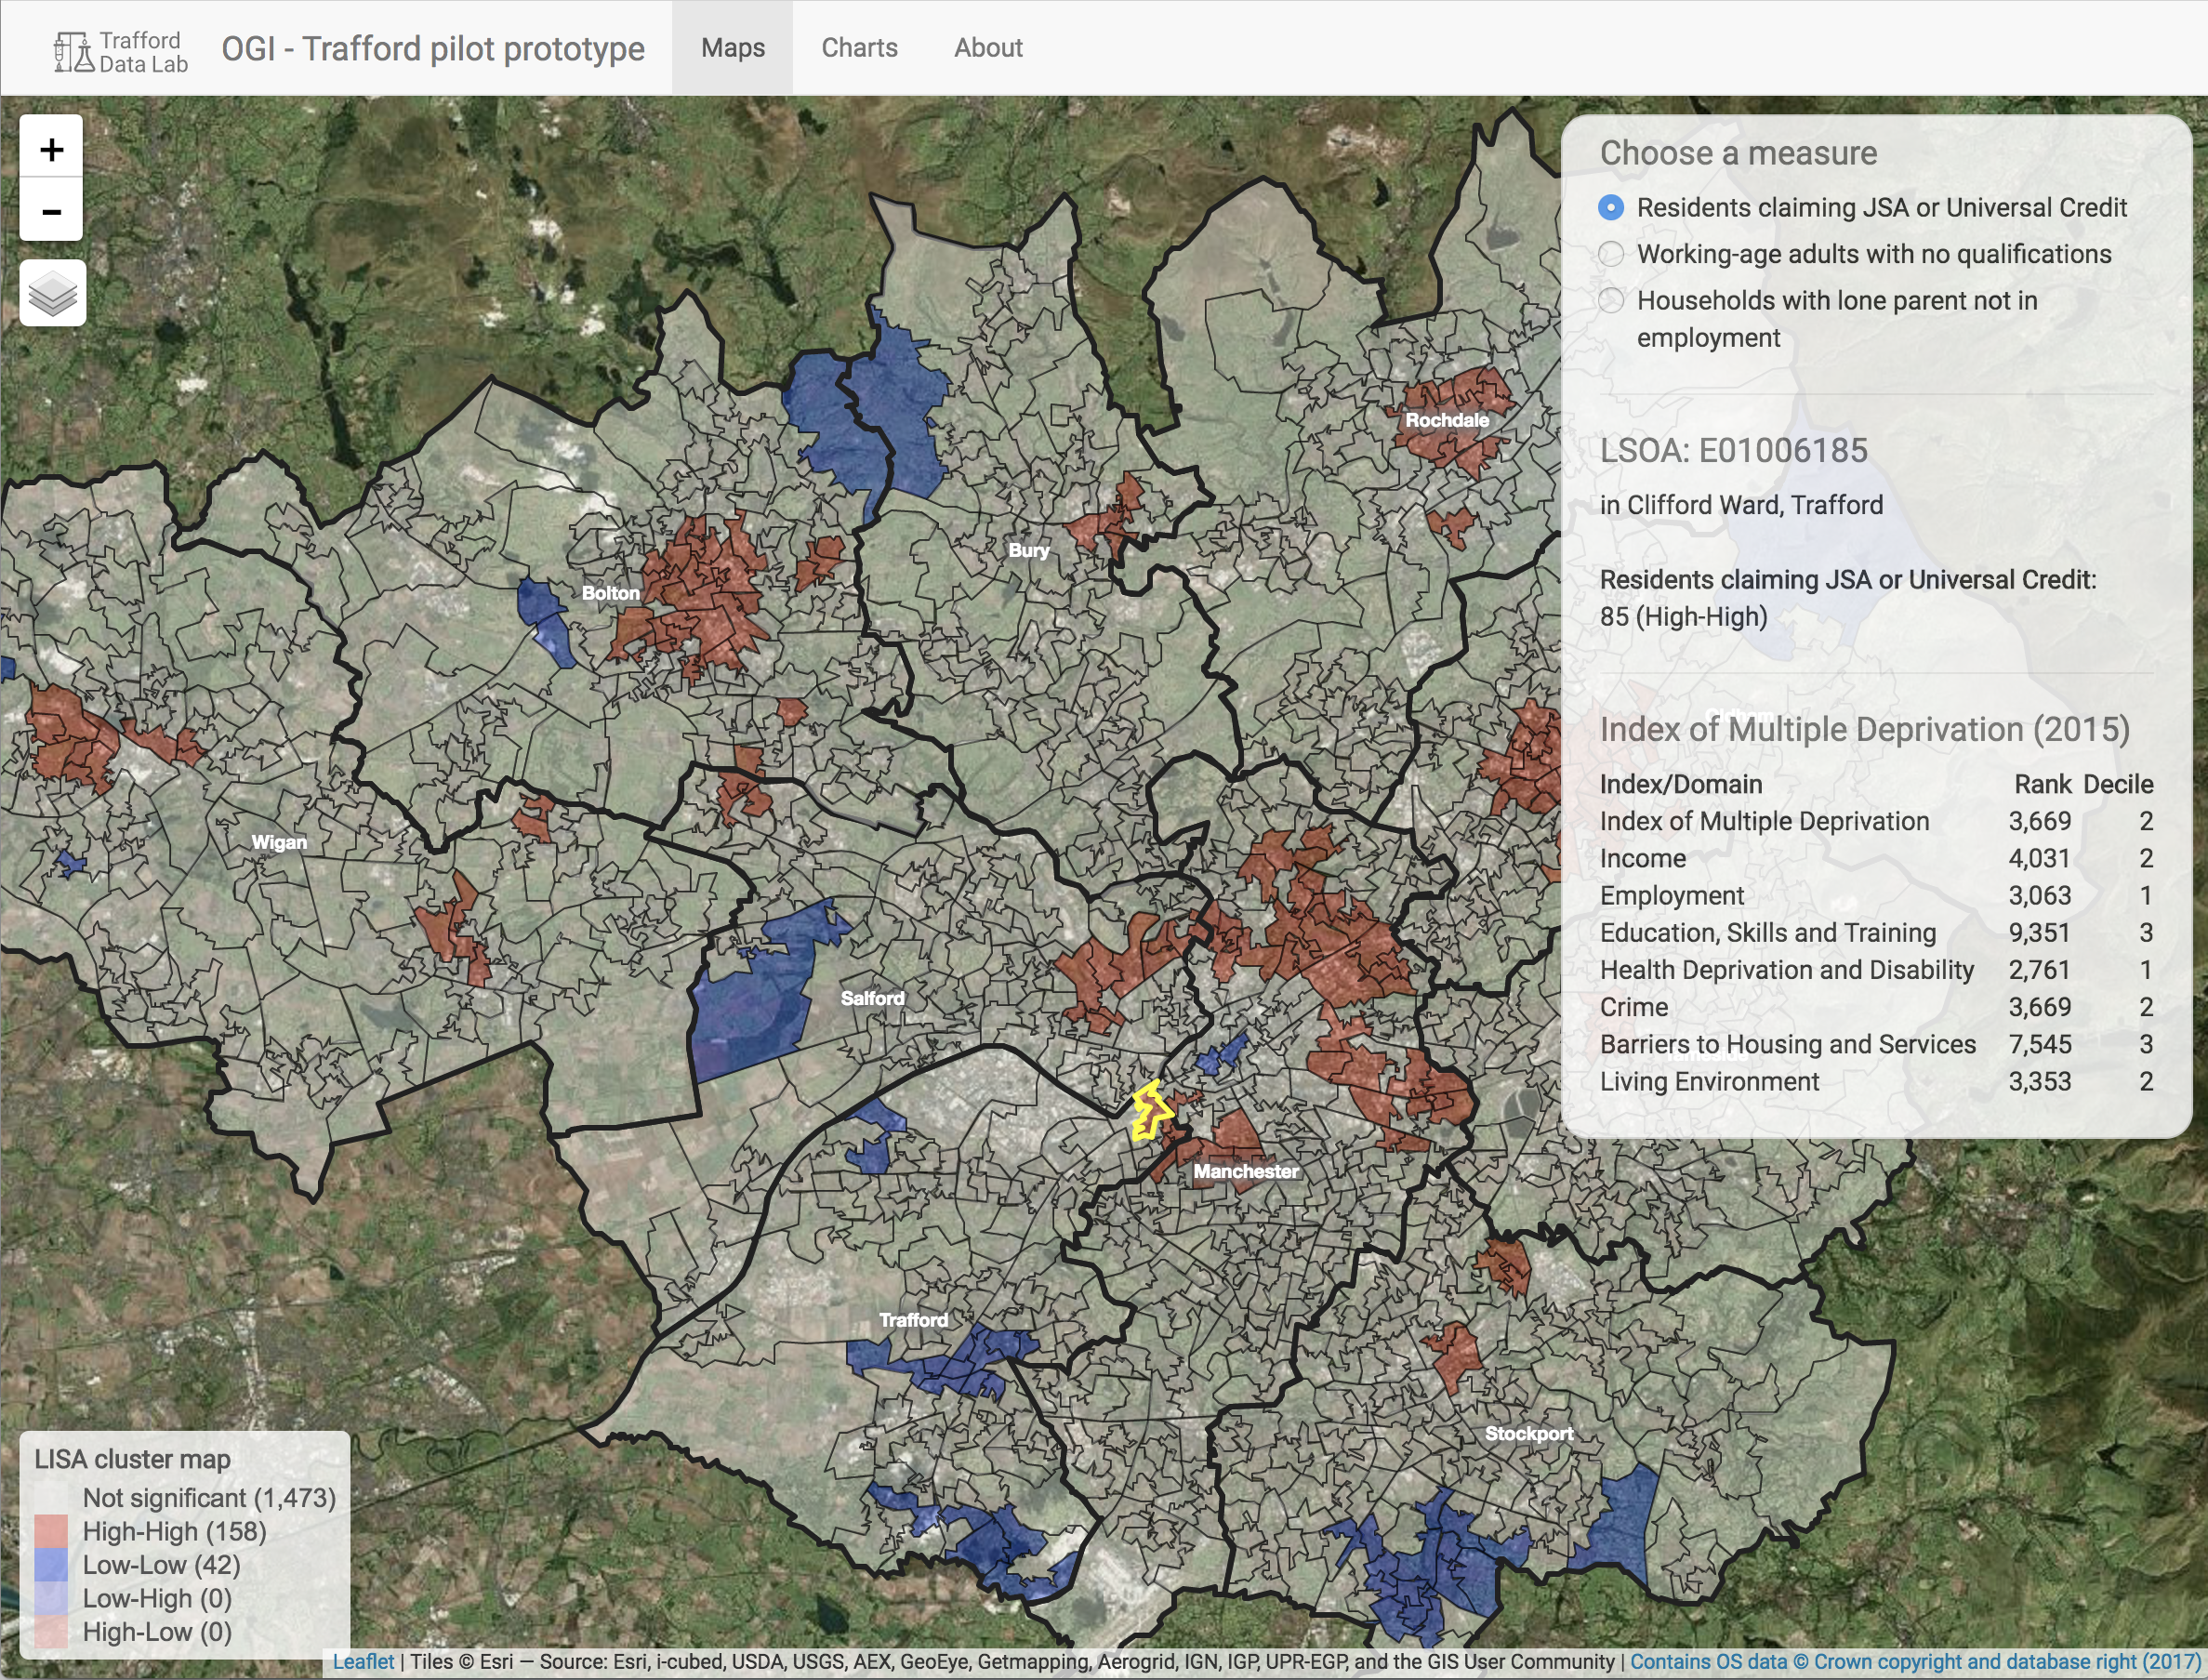

Slide 13
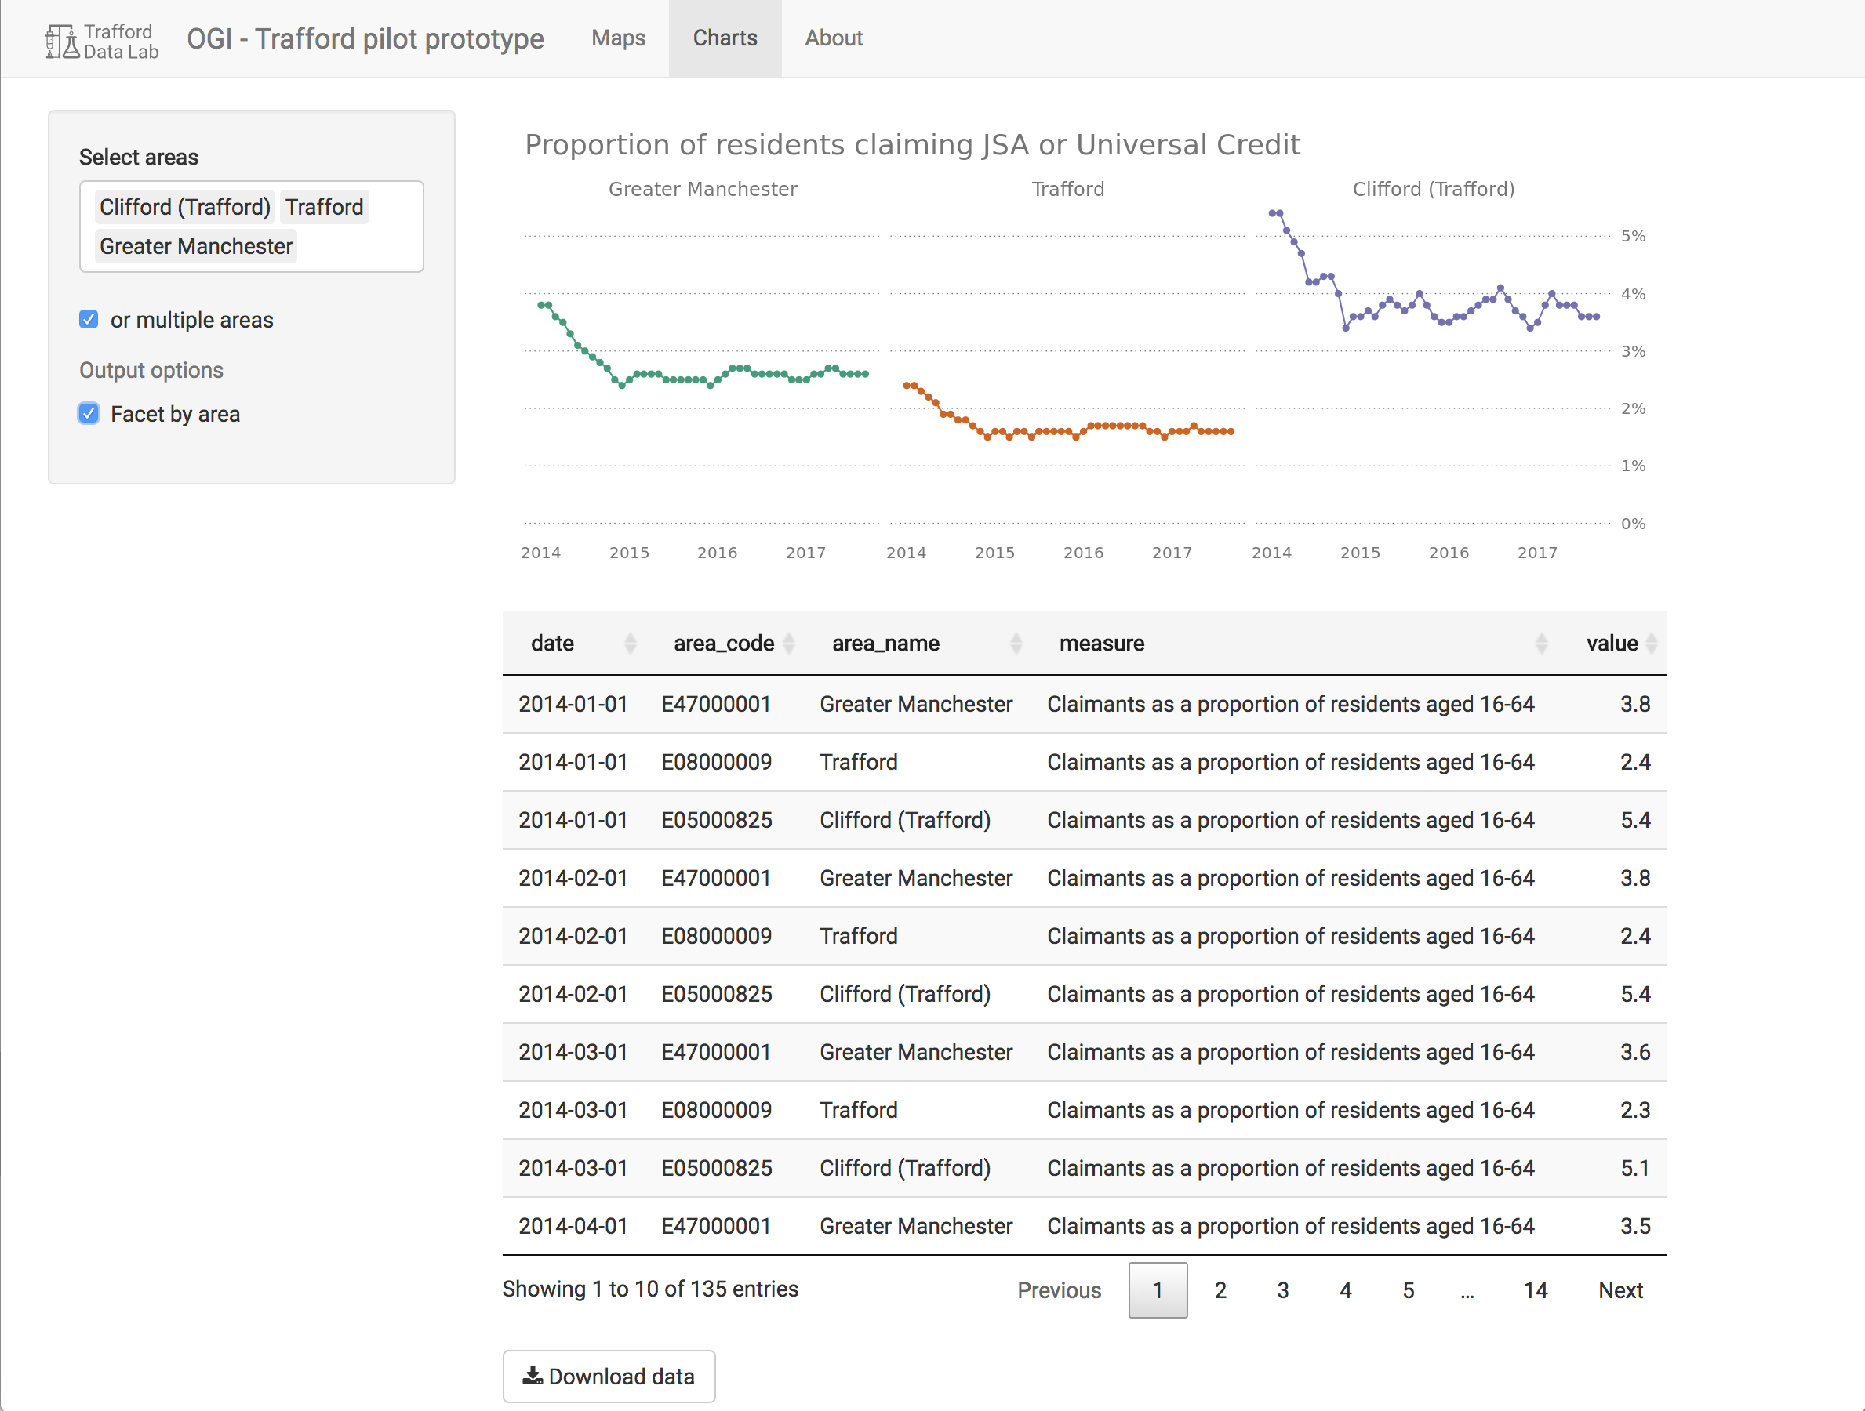

Slide 14
Co-creation: DWP
“I’m amazed that that is the result of the workshop because I didn’t feel that I contributed that much [..] However, if you’d asked me after what it is that I wanted that is it.”
Jobcentre Plus manager at user testing workshop, 11 November 2017

Slide 15
Wish list
- Interactive maps and charts
- Benchmarking
- Data download

Slide 16
Wish list: updated
- Additional datasets
- Option to render map by local authority

Slide 17
Roadmap
Implement
new
features
Add data
to GM DataStore
Gather feedback
Add CubiQL
Gather feedback
Co-implement

Slide 18
Dissemination
OpenGovIntelligence folder in GitHub repo

Slide 19
Questions?

